Slide 1
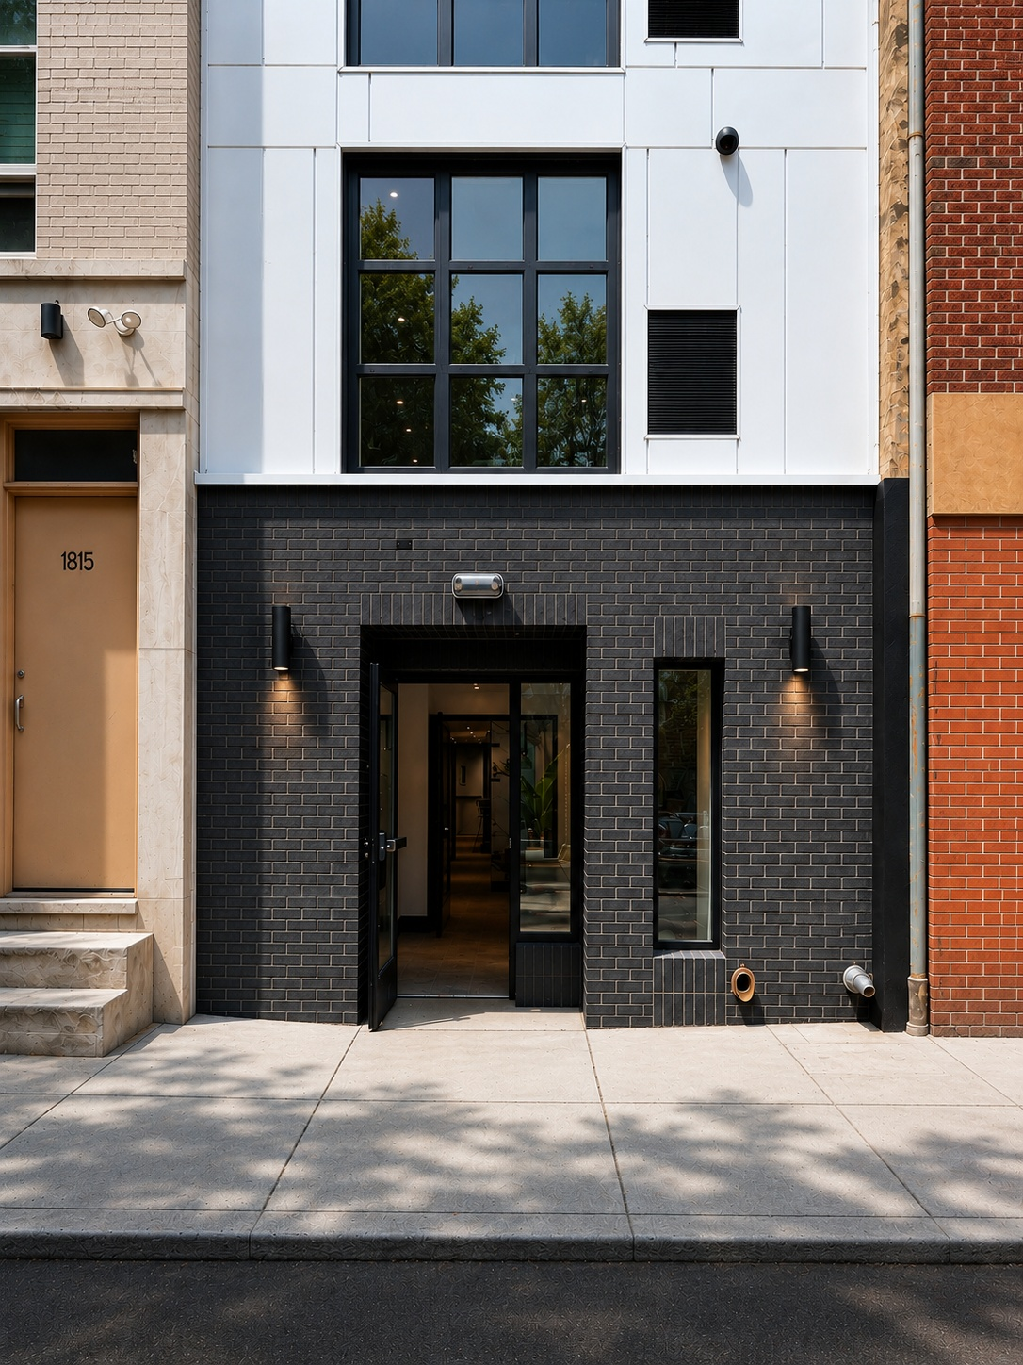

PREPARED BY TYW STUDIO.
A Rittenhouse
address. A place
to call your own.
Campaign kit · Version 2
Studios and one-bedrooms
12-month leases
THE RANSTEAD / CAMPAIGN KIT V2
01
Notes:
Campaign Kit V2. September 13, 2026. Brand, creative and lease requirements: supplied ASTRA-KIT-V2-BRIEF-2026-09-13.md and supplied Ranstead brand guide. Property imagery: original supplied Ranstead photos and walkthrough footage. Approved route concepts retained. No new property imagery.

Slide 2
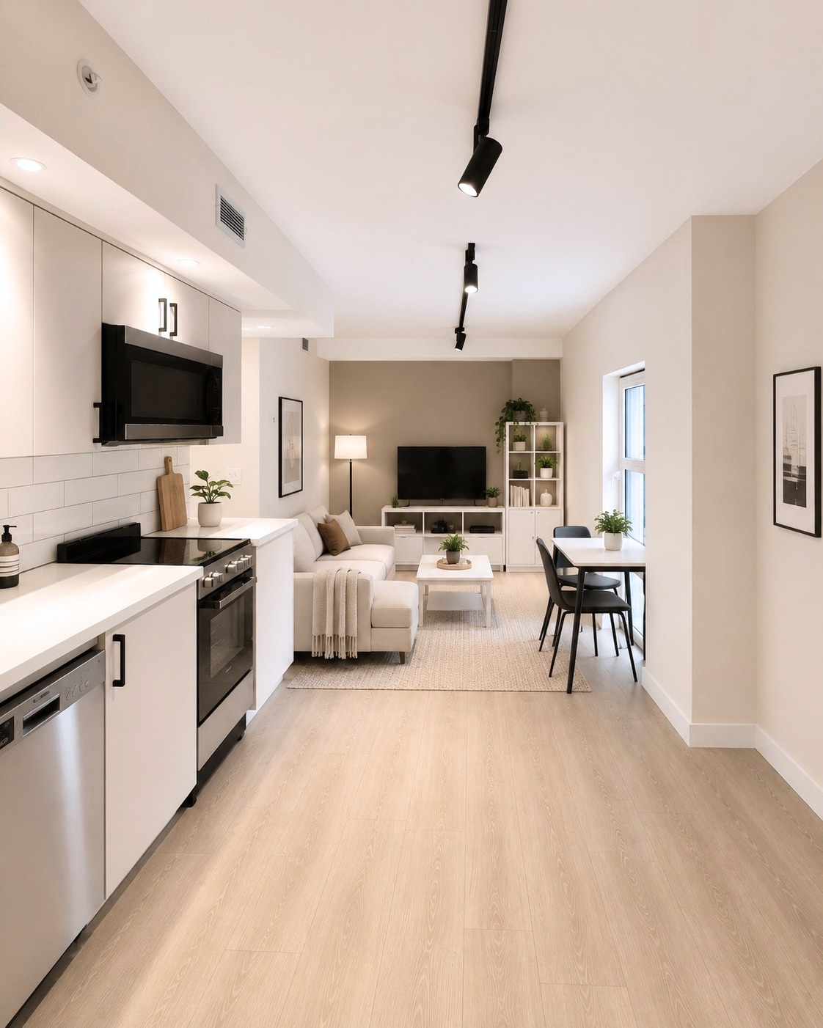
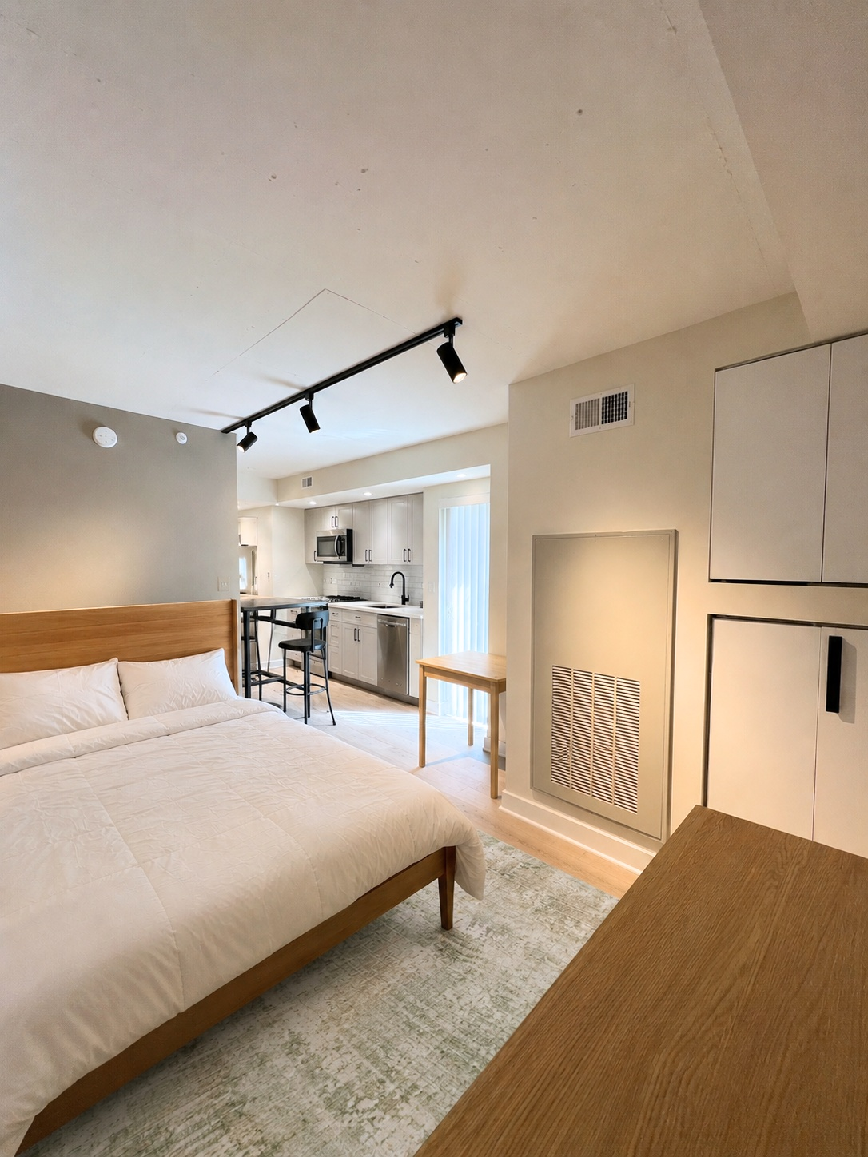
POSITIONING
The address comes first
01 The location
02 A new building
03 Your own place
Rittenhouse and Center City.
The neighborhood leads.
New construction, natural
light, and the details inside.
A studio or one-bedroom
with an address of your own.
THE RANSTEAD / CAMPAIGN KIT V2
02
Notes:
Campaign Kit V2. September 13, 2026. Brand, creative and lease requirements: supplied ASTRA-KIT-V2-BRIEF-2026-09-13.md and supplied Ranstead brand guide. Property imagery: original supplied Ranstead photos and walkthrough footage. Approved route concepts retained. No new property imagery.

Slide 3
ROUTE R1 / THE LOCATION
Rittenhouse.
At your door.
A Center City address.
12-month leases.
Explore the residences at theranstead.com.
THE RANSTEAD / CAMPAIGN KIT V2
03
Notes:
Campaign Kit V2. September 13, 2026. Brand, creative and lease requirements: supplied ASTRA-KIT-V2-BRIEF-2026-09-13.md and supplied Ranstead brand guide. Property imagery: original supplied Ranstead photos and walkthrough footage. Approved route concepts retained. No new property imagery.

Slide 4
ROUTE R2 / BRAND NEW
Brand new.
Ready for you.
New construction in Rittenhouse.
12-month leases.
Explore the residences at theranstead.com.
THE RANSTEAD / CAMPAIGN KIT V2
04
Notes:
Campaign Kit V2. September 13, 2026. Brand, creative and lease requirements: supplied ASTRA-KIT-V2-BRIEF-2026-09-13.md and supplied Ranstead brand guide. Property imagery: original supplied Ranstead photos and walkthrough footage. Approved route concepts retained. No new property imagery.

Slide 5
ROUTE R3 / YOUR OWN PLACE
Your address.
Your own place.
Studios in Rittenhouse.
12-month leases.
Explore the residences at theranstead.com.
THE RANSTEAD / CAMPAIGN KIT V2
05
Notes:
Campaign Kit V2. September 13, 2026. Brand, creative and lease requirements: supplied ASTRA-KIT-V2-BRIEF-2026-09-13.md and supplied Ranstead brand guide. Property imagery: original supplied Ranstead photos and walkthrough footage. Approved route concepts retained. No new property imagery.

Slide 6
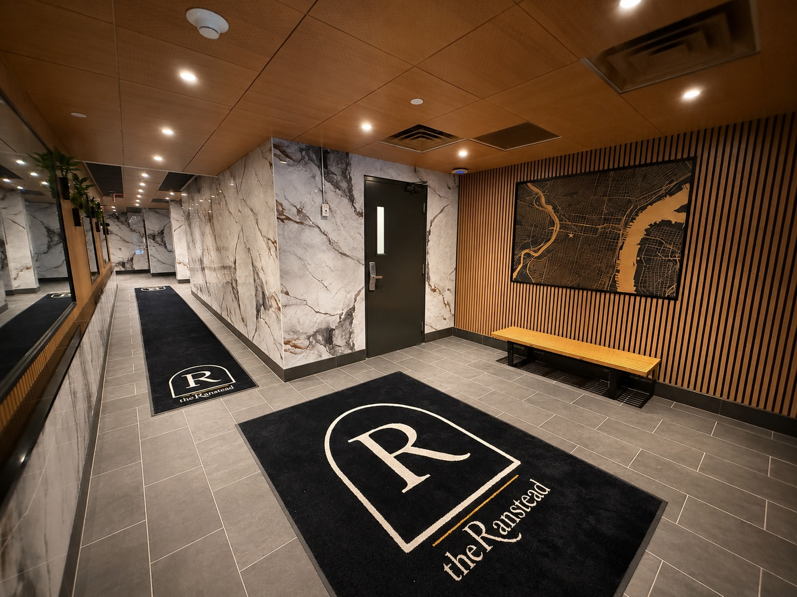
AUDIENCE APPROACH
Property and neighborhood
The building and location
Rittenhouse and Center City.
New construction. Residence layouts.
Use the approved V2 copy sheet.
Keep ad copy focused on the property
and neighborhood. The agency owns
campaign setup and targeting.
THE RANSTEAD / CAMPAIGN KIT V2
06
Notes:
Campaign Kit V2. September 13, 2026. Brand, creative and lease requirements: supplied ASTRA-KIT-V2-BRIEF-2026-09-13.md and supplied Ranstead brand guide. Property imagery: original supplied Ranstead photos and walkthrough footage. Approved route concepts retained. No new property imagery.

Slide 7
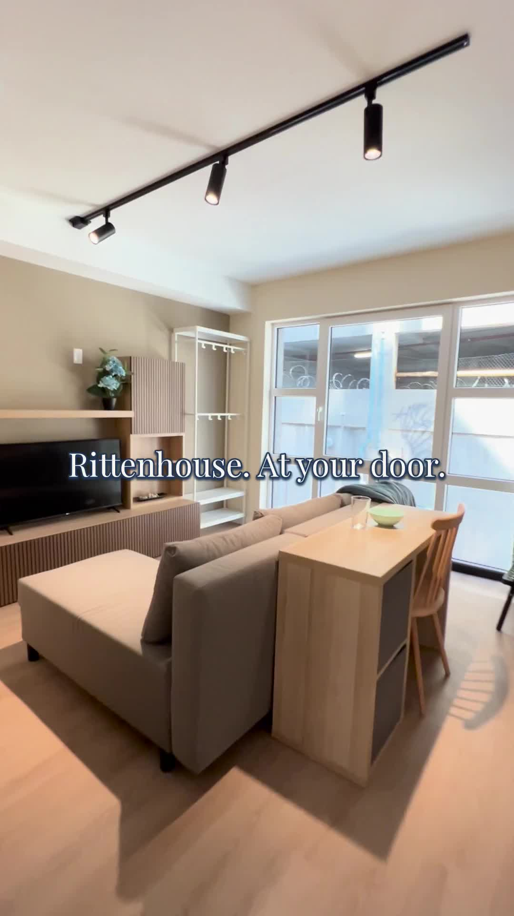
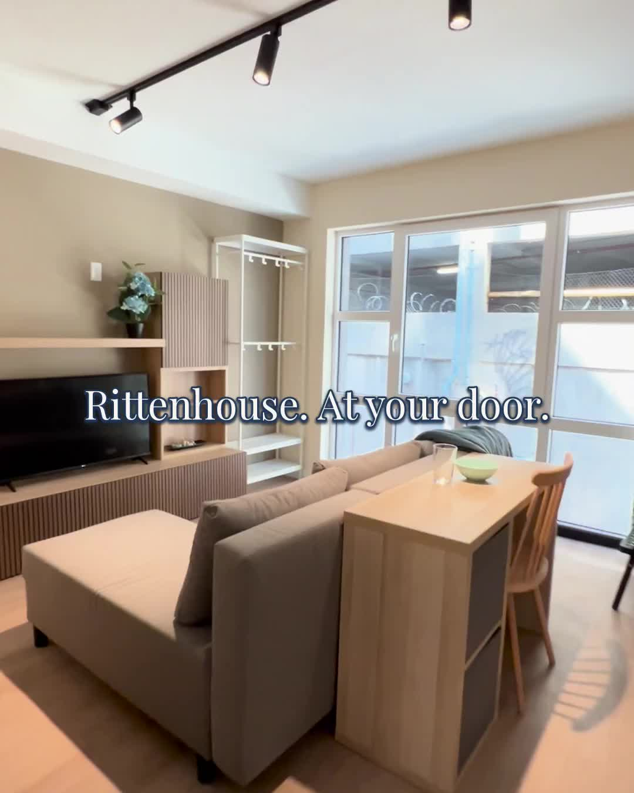
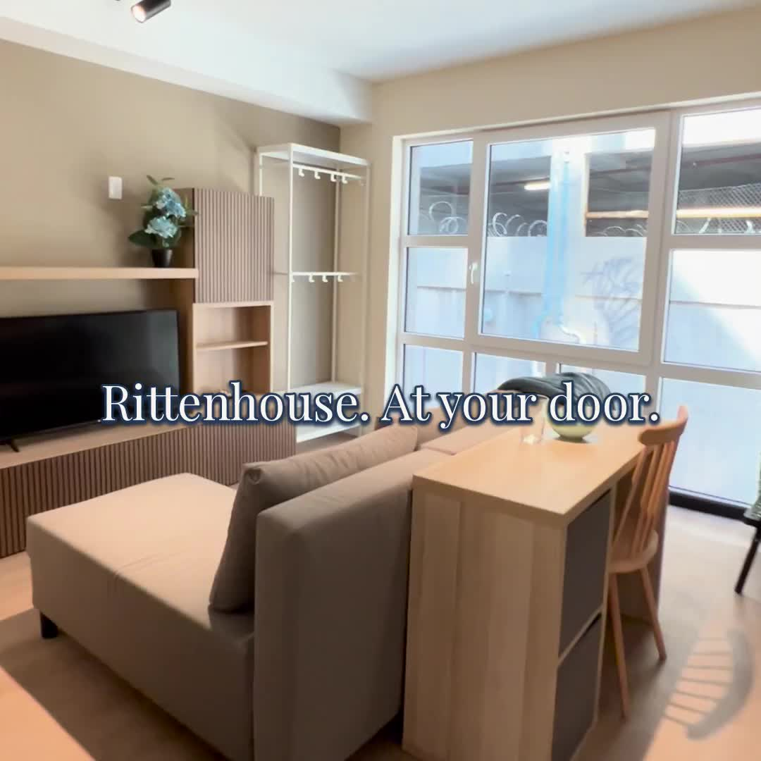
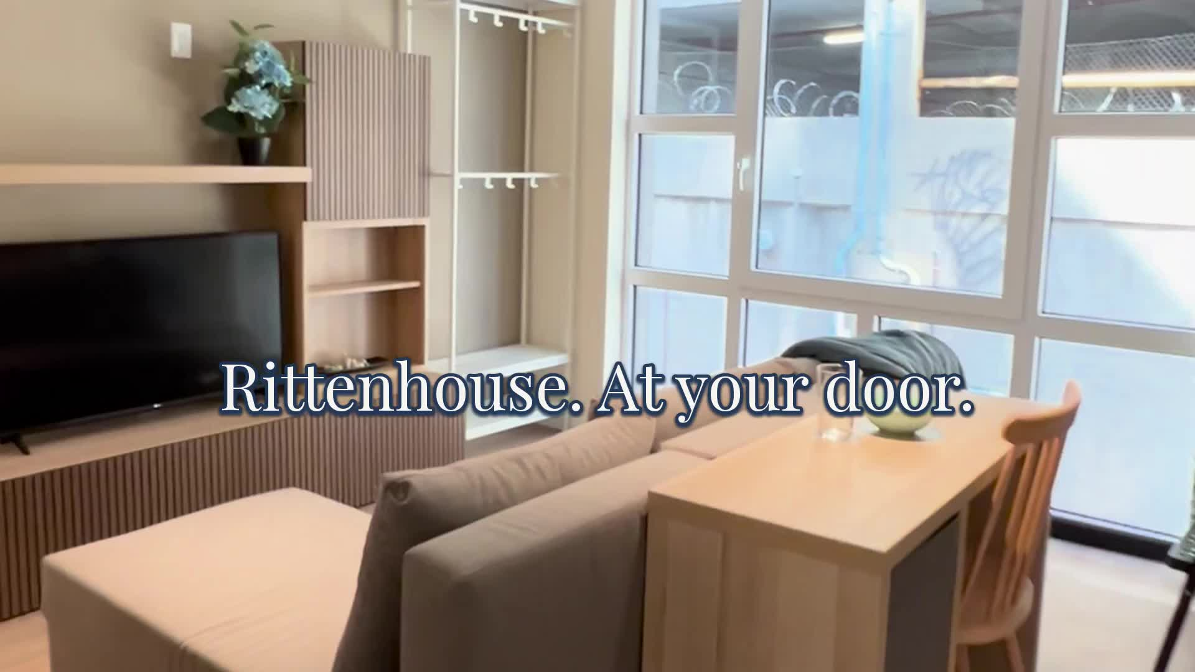
CREATIVE SYSTEM
Four formats. Clean and branded.
9:16 / Reels + Shorts
4:5 / Feed
1:1 / Feed
16:9 / YouTube
THE RANSTEAD / CAMPAIGN KIT V2
07
Notes:
Campaign Kit V2. September 13, 2026. Brand, creative and lease requirements: supplied ASTRA-KIT-V2-BRIEF-2026-09-13.md and supplied Ranstead brand guide. Property imagery: original supplied Ranstead photos and walkthrough footage. Approved route concepts retained. No new property imagery.
78 silent H.264 videos at 30 fps: clean and branded 6, 15, 30 seconds in 9:16, 4:5, 1:1, 16:9, plus 45-second 9:16 Shorts per route.

Slide 8
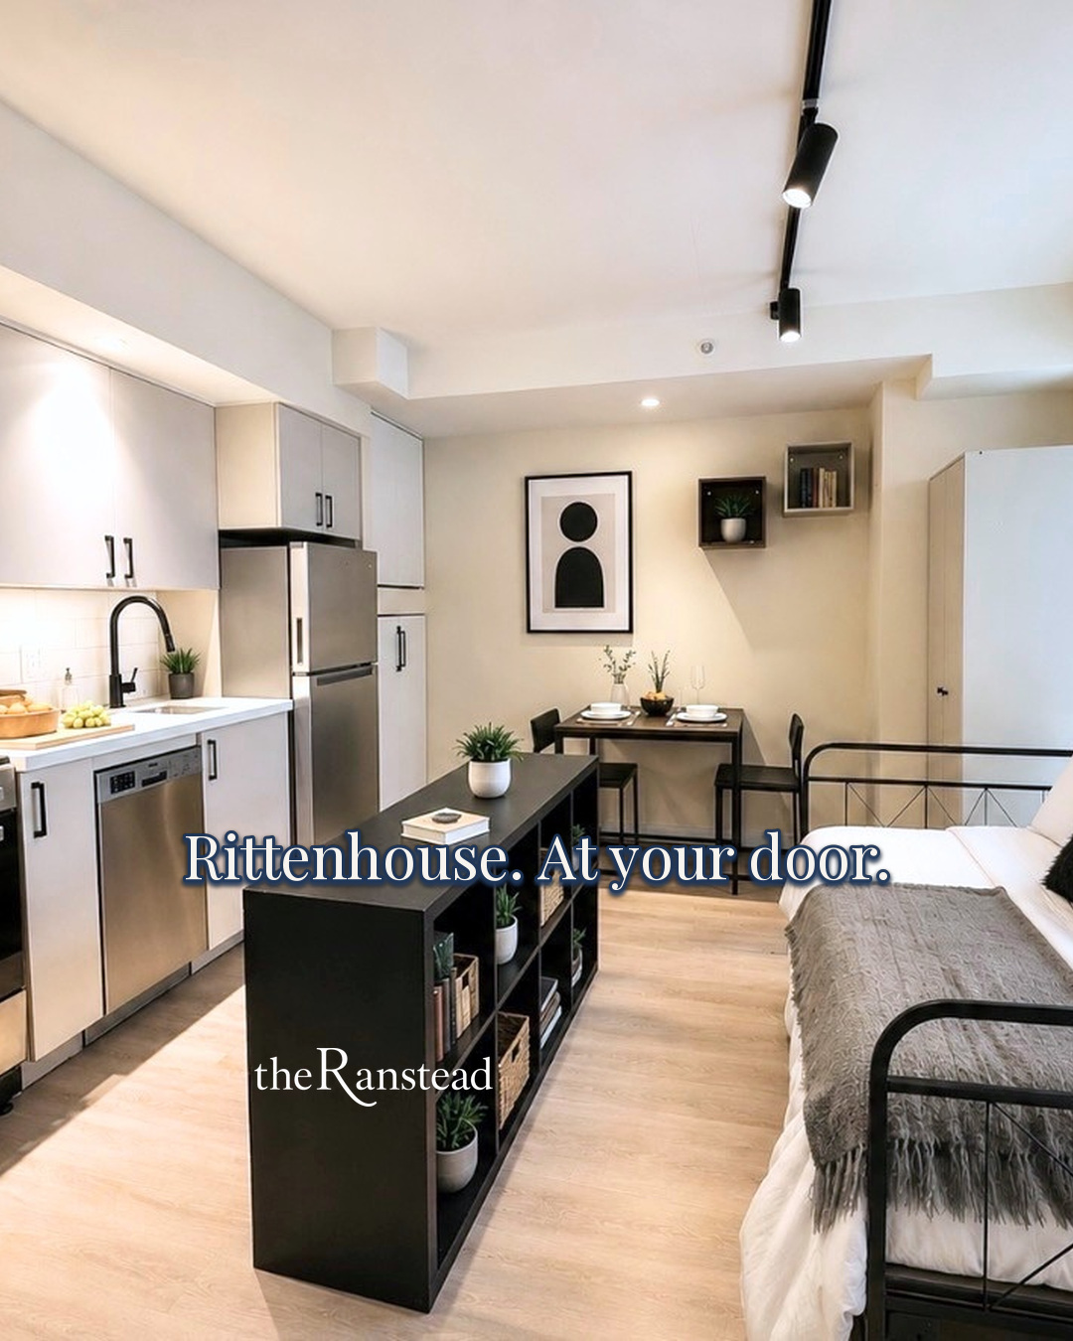

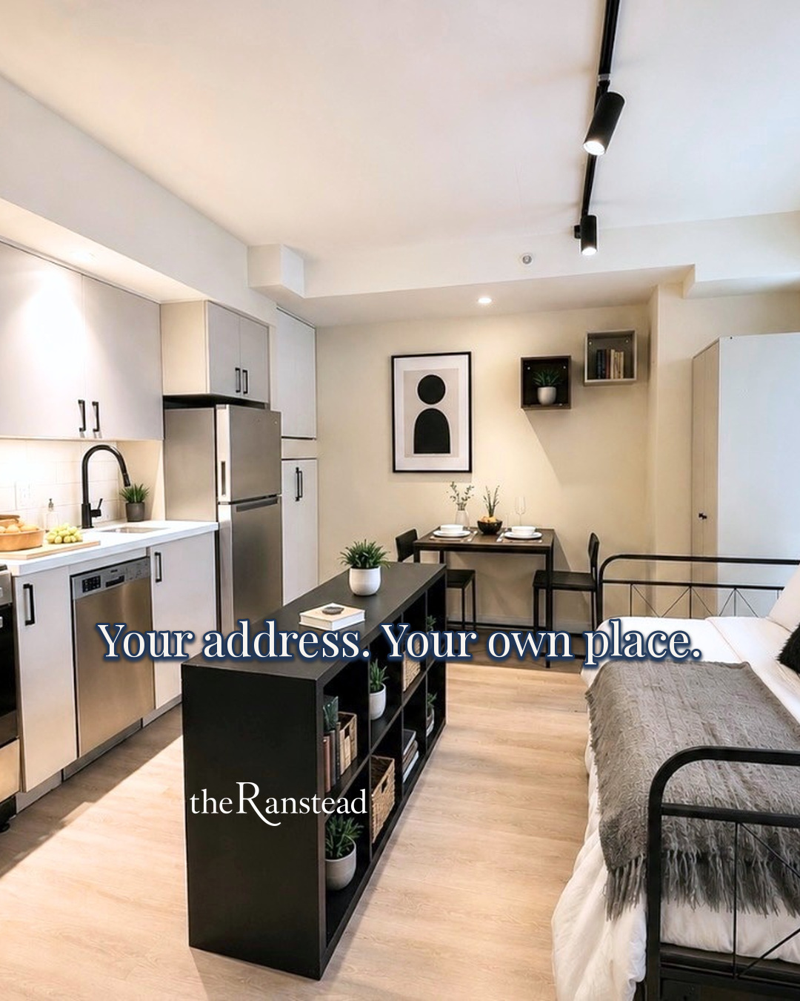
CONTROLLED TEST
A matched headline test
R1 / Location
R2 / Brand new
R3 / Your own place
THE RANSTEAD / CAMPAIGN KIT V2
08
Notes:
Campaign Kit V2. September 13, 2026. Brand, creative and lease requirements: supplied ASTRA-KIT-V2-BRIEF-2026-09-13.md and supplied Ranstead brand guide. Property imagery: original supplied Ranstead photos and walkthrough footage. Approved route concepts retained. No new property imagery.
Matched test example: identical photo, logo placement and format. Only the headline changes. Use comparable caption, CTA, budget and placement when running this test.

Slide 9
FOUR-WEEK ROLLOUT
Four-week rollout
Week 1
Launch R1 / R2 / R3
Confirm form and tour tracking.
Week 2
Compare matched headlines
Same visual, caption, CTA, placement, and budget.
Week 3
Extend the winning message
Fresh visuals. Consistent measurement.
Week 4
Review tours and leases
Refresh creative. Retain the results.
THE RANSTEAD / CAMPAIGN KIT V2
09
Notes:
Campaign Kit V2. September 13, 2026. Brand, creative and lease requirements: supplied ASTRA-KIT-V2-BRIEF-2026-09-13.md and supplied Ranstead brand guide. Property imagery: original supplied Ranstead photos and walkthrough footage. Approved route concepts retained. No new property imagery.

Slide 10
MEASUREMENT
Campaign measurement
Cost per booked tour
Spend ÷ attributed booked tours
Tour show rate
Attended tours ÷ booked tours
Tour-to-lease rate
Signed leases ÷ attended tours
Cost per lease
Spend ÷ attributed signed leases
Use one attribution window. Deduplicate inquiries. Allow time to tour and sign.
THE RANSTEAD / CAMPAIGN KIT V2
10
Notes:
Campaign Kit V2. September 13, 2026. Brand, creative and lease requirements: supplied ASTRA-KIT-V2-BRIEF-2026-09-13.md and supplied Ranstead brand guide. Property imagery: original supplied Ranstead photos and walkthrough footage. Approved route concepts retained. No new property imagery.

Slide 11
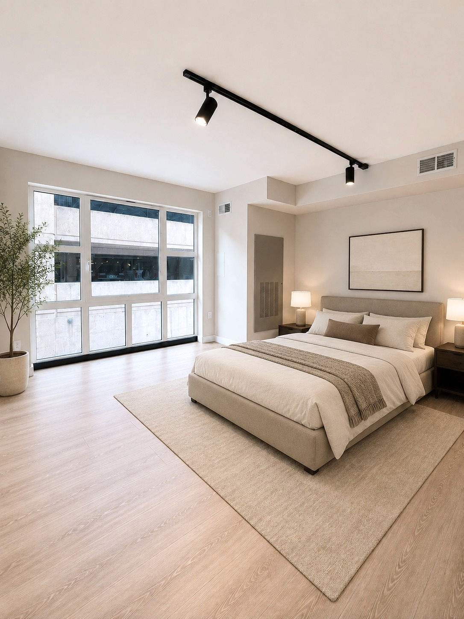
LANDING-PAGE DRAFTS
Landing-page handoff
Five existing drafts with the agency.
Blue Collar Digital owns the rewrites.
Use the approved V2 copy and brand guide
when preparing the final pages.
V1 drafts remain available as reference.
The agency will confirm the campaign destinations.
THE RANSTEAD / CAMPAIGN KIT V2
11
Notes:
Campaign Kit V2. September 13, 2026. Brand, creative and lease requirements: supplied ASTRA-KIT-V2-BRIEF-2026-09-13.md and supplied Ranstead brand guide. Property imagery: original supplied Ranstead photos and walkthrough footage. Approved route concepts retained. No new property imagery.

Slide 12
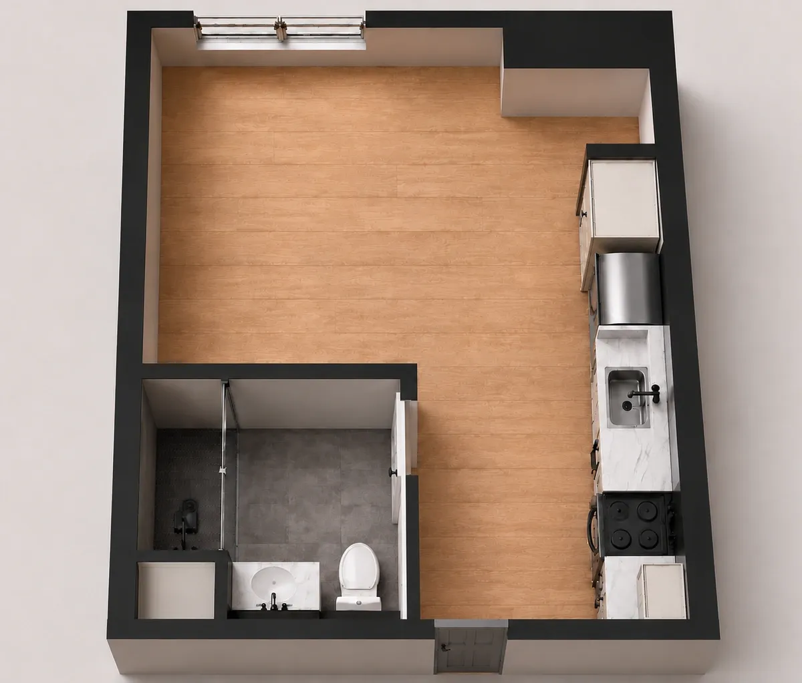
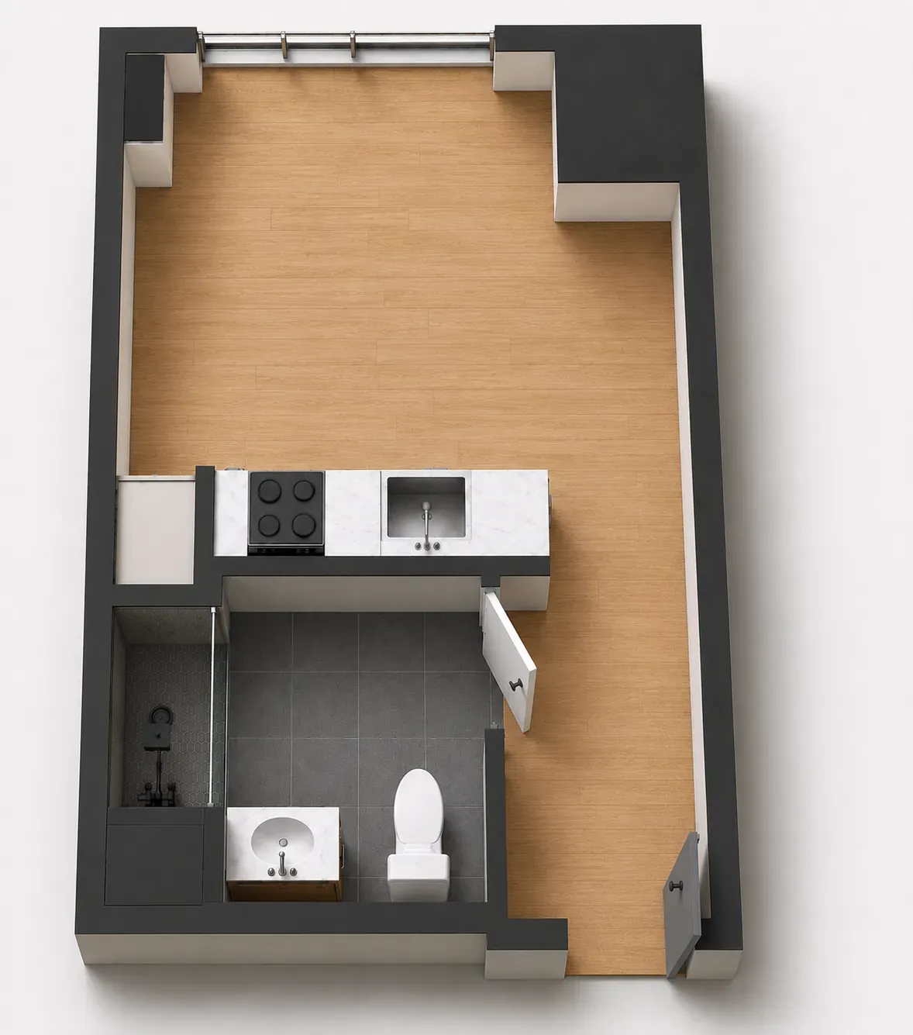
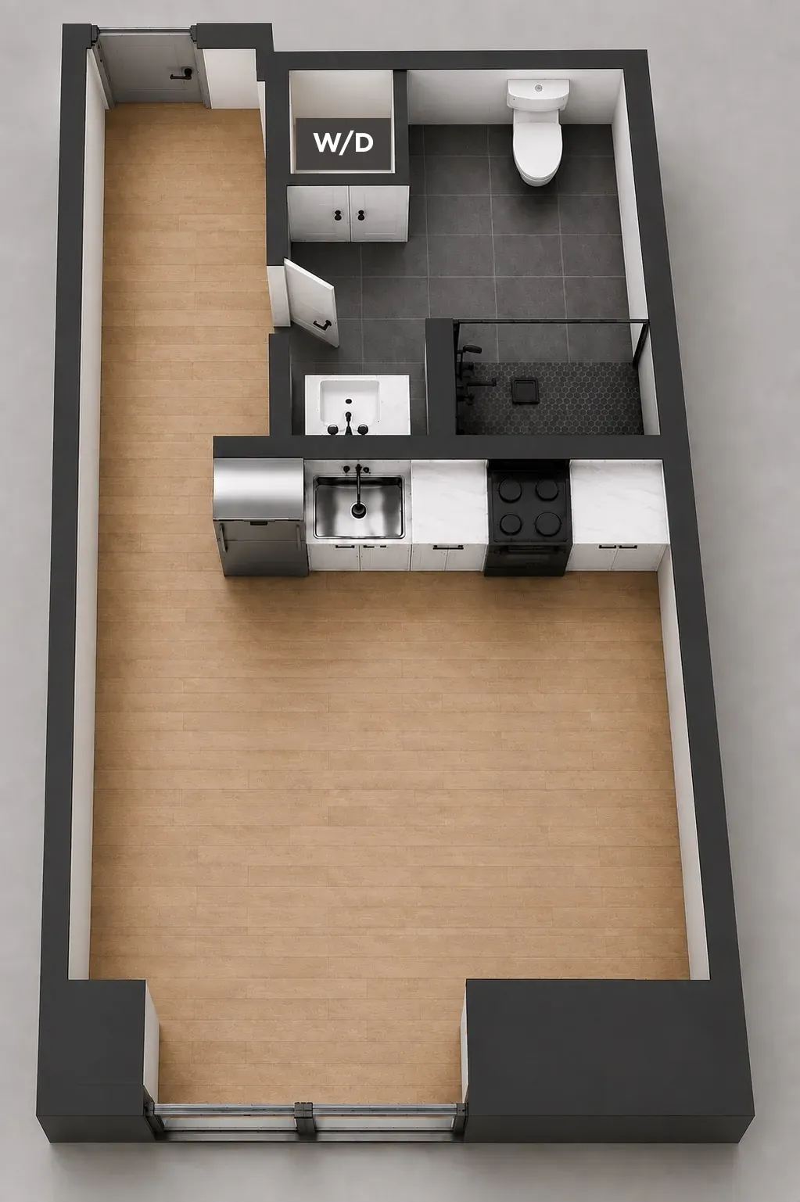
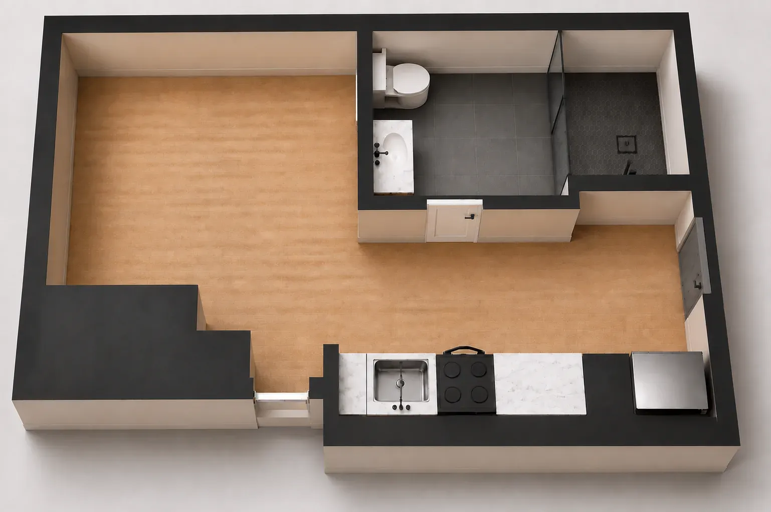
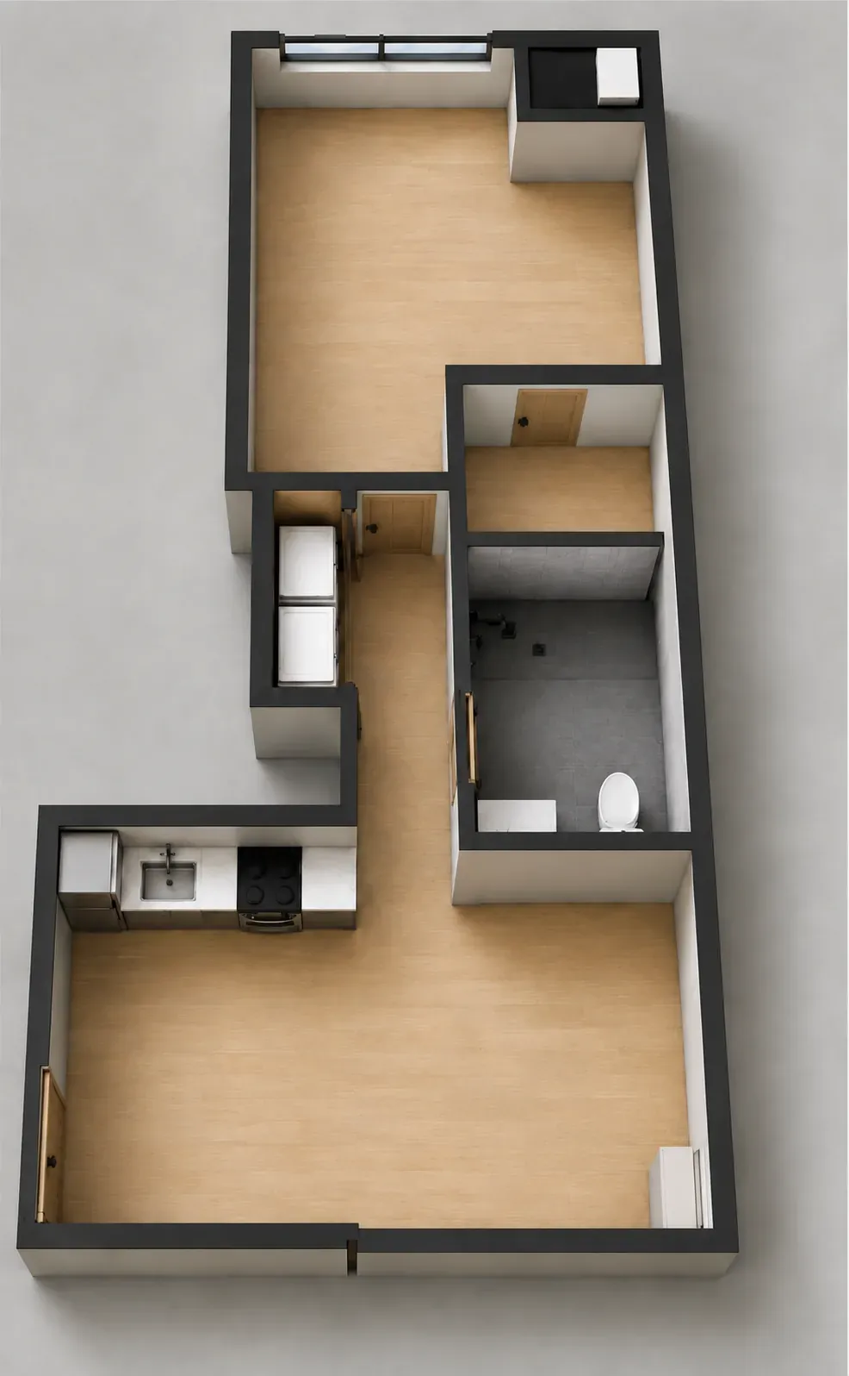
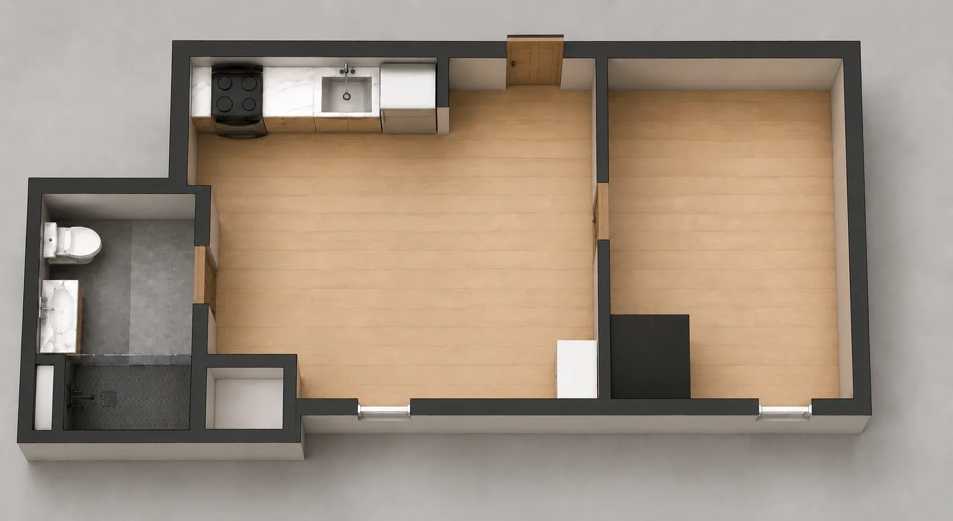
RESIDENCE LAYOUTS
Residence layouts
Studio B1
Studio B2
Studio B5
Studio B6
One Bedroom B3
One Bedroom B4
THE RANSTEAD / CAMPAIGN KIT V2
12
Notes:
Campaign Kit V2. September 13, 2026. Brand, creative and lease requirements: supplied ASTRA-KIT-V2-BRIEF-2026-09-13.md and supplied Ranstead brand guide. Property imagery: original supplied Ranstead photos and walkthrough footage. Approved route concepts retained. No new property imagery.

Slide 13
NEXT CAPTURE
Next capture
Street-level facade
Centered, level, in soft light. Include the full building.
Neighborhood motion
The actual approach, sidewalks, and verified local context.
Additional room footage
Slow turns. Level camera. Full doorways and fixtures.
THE RANSTEAD / CAMPAIGN KIT V2
13
Notes:
Campaign Kit V2. September 13, 2026. Brand, creative and lease requirements: supplied ASTRA-KIT-V2-BRIEF-2026-09-13.md and supplied Ranstead brand guide. Property imagery: original supplied Ranstead photos and walkthrough footage. Approved route concepts retained. No new property imagery.

Slide 14
AGENCY HANDOFF
The campaign kit
Campaign site
campaign.theranstead.com
Preview and download every format.
Copy sheet
Meta, Google Search, and YouTube.
One tab per route, with character counts.
Shared Drive folder
Clean masters, branded exports,
source photos, brand assets, and deck.
THE RANSTEAD / CAMPAIGN KIT V2
14
Notes:
Campaign Kit V2. September 13, 2026. Brand, creative and lease requirements: supplied ASTRA-KIT-V2-BRIEF-2026-09-13.md and supplied Ranstead brand guide. Property imagery: original supplied Ranstead photos and walkthrough footage. Approved route concepts retained. No new property imagery.

